Slide 1
Karmela Krleža-Jerić, MD. M.Sc. D.Sc. Ottawa Group, IMPACT Observatory karmela@krleza.com & krlezajk@hotmail.com
Access to clinical trial data (part 2):
IMPACT Observatory and managing privacy risks
Part 2.3.
IMPACT Observatory cont.: Initiatives, Repositories, Conclusion
Cochrane - GESI Webinar 2019

Slide 2
Karmela Krleža-Jerić, MD. M.Sc. D.Sc. Ottawa Group, IMPACT Observatory karmela@krleza.com & krlezajk@hotmail.com
Access to clinical trial data (part 2):
IMPACT Observatory and managing privacy risks
Part 3:
IMPACT Observatory cont.: Initiatives, Repositories, Conclusion
Cochrane - GESI Webinar 2019

Slide 3
Poll 3:
Did you ever perform or participate in performing of (check all that apply)
Systematic review
Meta-analysis of aggregate data
Meta analysis of IPD
None of the above

Slide 4
Methodology
Network/WG
Scoping review
barriers opportunities gaps
Surveys & Interviews
Indicate trends
Enviro scan Initiatives
Impact transition
Enviro scan of Repositories

Slide 5
Initiatives
FAIRSHARING
VIVLI
bioCADDIE
ICMJE
FUNDERS
COCHRANE
IOM
DataSphere
REGULATORS
YODA
REPOSITORIES
CSDR
BIOGRID AUSTRALIA
ECRIN-CORBEL STUDY
WHO
DOH
RESEARCH DATA AUSTRALIA
CTTI
OTTAWA STATEMENT

Slide 6
15
4
3000+
Available trials
IPD
requests
CSDR
Consortium
YODA Project
pharma
Public funders
94.5%
Platform
270
113
trials
Project
Data Sphere
Trials
3200+
Members
16
Countries
100
Vivli
32
Data Providers
Platform
189
Datasets
2,213
Users

Slide 7
How
establish partnership with data providers
investigators request - reviews
independent scientific reviews
data provider review
data provider/company final approval

Slide 8
Methodology
Network/WG
Scoping review
barriers opportunities gaps
Surveys & Interviews
Indicate trends
Enviro scan Initiatives
Impact transition
Enviro scan of Repositories

Slide 9
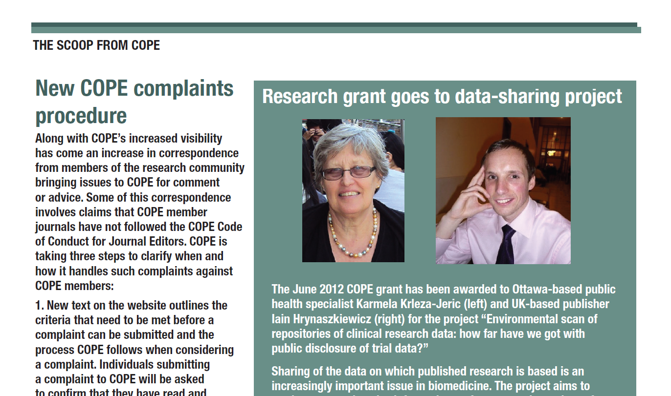

Slide 10
Environmental scan of repositories
Objective
Identify and explore essential features and practices of repositories that
accept clinical trial data including IPD
facilitate their public disclosure
Use/ KT
Inform
Raise awareness
Help plan the future
Encourage collaboration btw repositories and other players
To achieve public disclosure of trial data and change of research paradigm
2016-Collaboration/Participation

Slide 11
Methodology
Selection/inclusion criteria
Search
Data collection
Analysis
Reporting
Repositories in public domain that harvest clinical trial raw data with a goal of enabling sharing and public disclosure
Define features-
develop headings in Excel
Extract data from Internet/ re3data/ repository websites/ literature/ repository managers
Coding
Analysis
Assessment
Trends
Internet
Registries of repositories
Re3data
Literature
other sources
Presentations
Conferences
Internet - websites
Publications

Slide 12
Research Data Repositories
provide access to data
archive
store and maintain data
enable share, reuse
necessary to achieve the full transparency of research
open data

Slide 13
Challenges
Learning process select and exclude
Platforms , Initiatives, Projects , Portals
Dynamic area - evolution of repositories number and features

Slide 14
58 headings in 6 sections
General (name, url, source)
Type of repository (academia, pharma, consortia, geo coverage)
Data (who can upload, download, formats, citability)
Organisational framework ($, ownership, partnership)
Ethics
Architecture (GUI, Researcher to data environment, query, social commentary, templates

Slide 15
GENERAL
DATA STANDARDS
CITABILITY OF DATA
DATA FORMAT
CONTROL OF QUALITY
PARTNERSHIP
ARCHITECTURE
SECONDARY USE ACCESS
WHO CAN UPLOAD
TYPE OF RESEARCH DATA
Query system
GUI
Online analysis
Access data in situ vs download
Report templates
Social notification/ commentary
Researcher to data interface
Standards
Data use agreements
Open
free to download & no legal barriers to reuse
Limited /Restricted
upon request
qualified researcher
Conditions
data use agreement
no sharing
Closed
responsible organisation only
Combination
SAS
SPSS
Stata Files
Non specific
Depends on data
as is
multiple formats to enable accessibility
Journals /publishers
Dryad- BMJ
Figshare- PLoS, Faculty 1000
ORCID
Funding agencies
Governments
Consortia
Pharma-Academy
Yoda-Medtronic
publications
any standard file
images, graphs, video
multimedia & audiovisual
datasets
outcome data
summary data
raw data
individual participant data
metadata
Anyone
Anyone from a given county
Institution based
Collaborators of
Only if published
At entrance:
Extensively curated at entrance
To certain extend
As is
Once in the repository:
heterogeneity
maintenance curatorship
Name
URL
DOI
Re3data
Scientific Area
Geo-coverage
DOI
URN
ARK
Handle
PURL
Persistent identifier system HDL
Repository/ registry ID
Unique Patient Number
No universal standards
Leave to submitter and journal
Range of standards
Defined
No specific
No specific fields
Any
As is
API - APPLICATION PROGRAMMING INTERFACE
URL
REPOSITORY NAME
ETHICS GUIDELINES
SCIENTIFIC AREA
DATA FORMAT
TYPE OF REPOSITORY
TYPE OF RESEARCH DATA
TYPE OF OWNERSHIP
CONTROL OF QUALITY
REQUIREMENTS TO FACILITATE MULTIPLE SECONDARY USES
NETWORKING
ACCEPTABLE SIZE
PRIVACY & ANONYMISATION
GEO-COVERAGE
GOVERNANCE MODELS
ARCHITECTURE
PARTNERSHIP
POLICIES
COST AND FINANCIAL STRUCTURE
WHO CAN UPLOAD
CITABILITY OF DATA
DEFINITION OF RAW DATA
SECONDARY USE ACCESS
ONLINE HELP
UPDATES (ARCHIVE VS. OVERWRITE)
DATA STANDARDS
SOCIAL NOTIFICATION SYSTEM
GRAPHICAL USER INTERFACE (GUI)
CURATED
SERVICE LEVEL AGREEMENT (SLA)

Slide 16
Repositories registered in re3data
600
1275
1415
2224
2300
2019:
29 host CT data:
14 general
12 disease specific
3 domain
1347

Slide 17
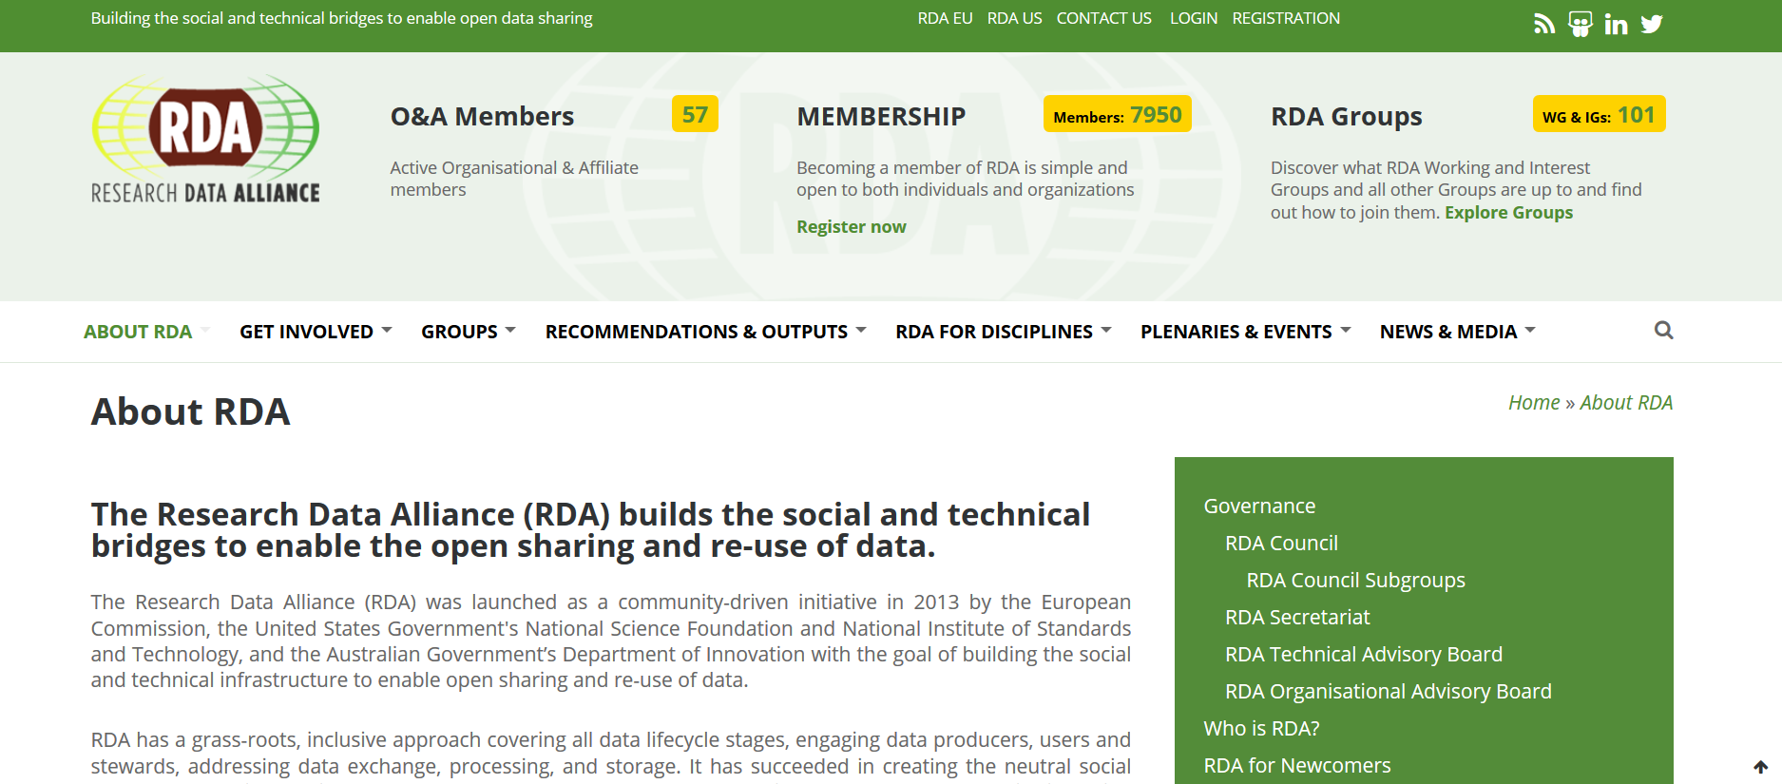
What we learned so far
Repository types
Scientific area/ scope
General any research (14)
Disease specific (12)
Domain / Clinical trials repository (3)
Geo coverage: Global– Regional – International - Country - Institutional
Combination & evolution
RDA – Research Data Alliance https://rd-alliance.org/repositories
Certificates
CoreTrust Seal Certificate (WDS, DSA)
Repositories assign PID to data sets
re3data registry of research data repositories
DataCite manages re3data and assigns DOI to repositories
re3data valuable source of info on repositories
but search issues- specific descriptors are needed
No universally accepted standards
Heterogeneity

Slide 18
Repositories hosting CT data
2
DOMAIN
PID
14
5
CERTIFICATE
16
4
INSTITUTIONAL
REPOSITORIES
3
NATIONAL
7
OPEN ACCESS
7
GLOBAL
1
MULTINATIONAL
1
REGIONAL

Slide 19
General Repositories hosting CT data 2019
ArrayExpress |  |  | B2Share
DRUM |  |  | Dryad
EASY |  |  | Edinburg Datashare
Figshare |  |  | Harvard dataverse
ICPSR |  |  | LSHTM Data Compass
University of Bath Res Data Archive |  |  | OSF (Open Science Framework)
SND |  |  | Zenodo

Slide 20
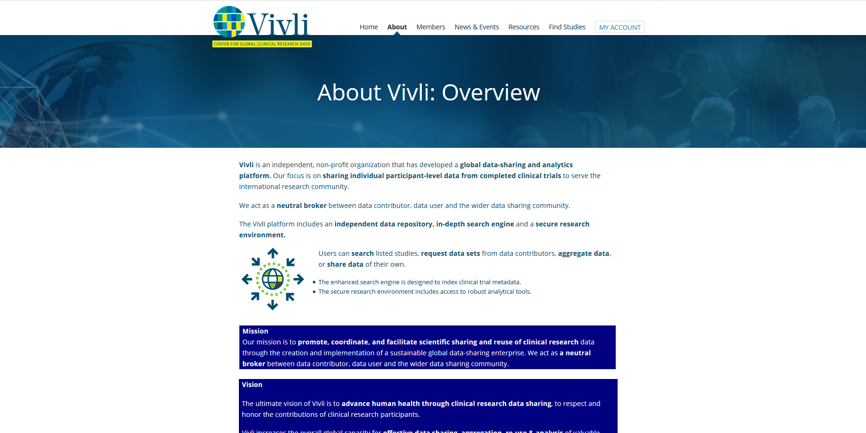
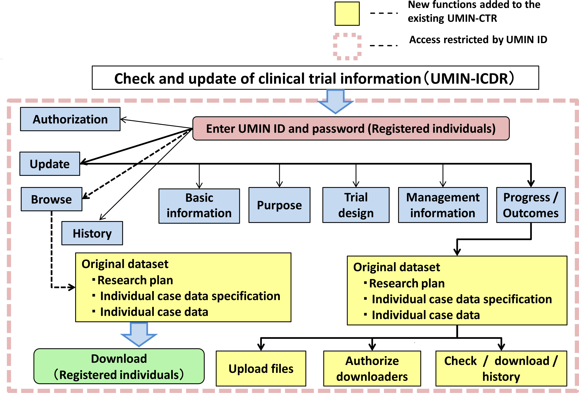
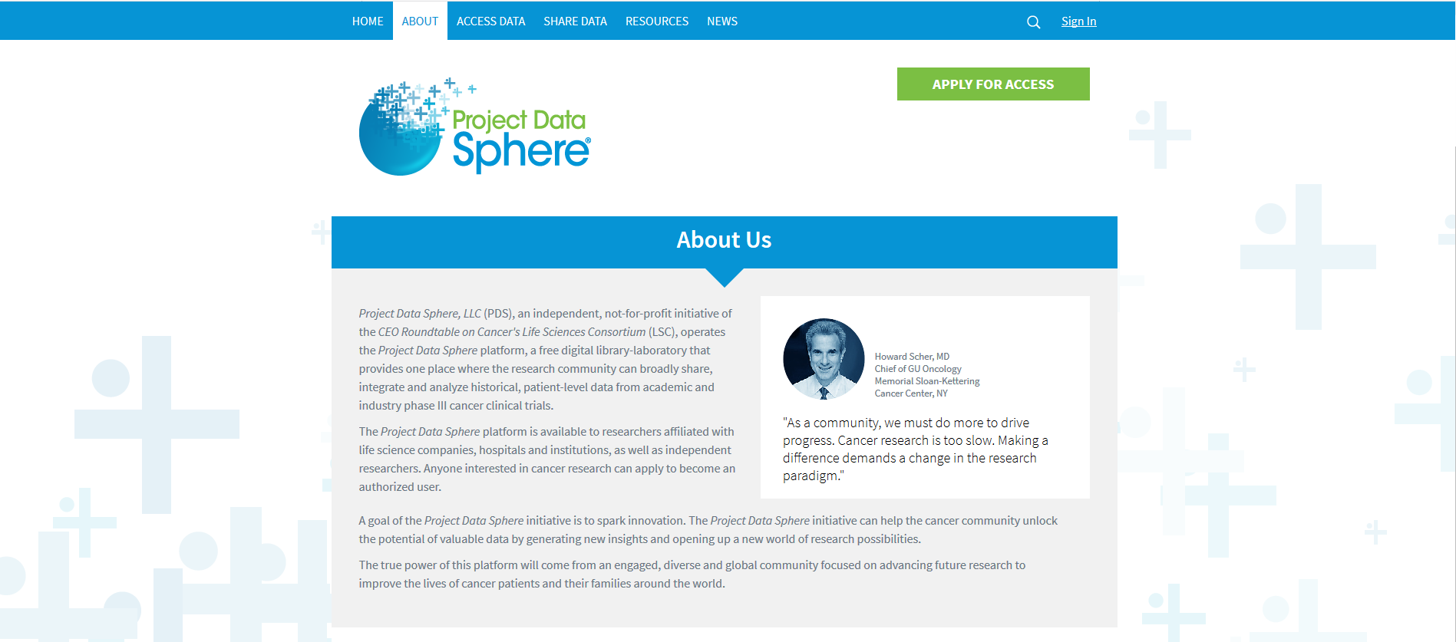
Domain repositories
Any Clinical trial
Disease specific clinical trials
UMIN Clinical Trials Registry (UMIN-CTR)

Slide 21
This environmental scan will
Inform development of methodologies and standards
Raise awareness
Encourage collaboration between
Repositories
Researchers, journals, publishers, and data repositories
to achieve
public disclosure of trial data

Slide 22
REPOSITORIES hosting CT data
Exist
Features keep improving
Domain repository shortage
Improvement and development needed

Slide 23
Poll 4
Would you agree to participate in an online survey by IMPACT Observatory about this issue? Yes/No

Slide 24
CONCLUSION

Slide 25
Access to data will contribute to
Research integrity
Quality of studies
Reducing
publication bias
waste
Avoiding
unnecessary trials
harmful trials to be repeated
Reliability of evidence
Regaining public trust
Knowledge creation
Better diagnostics and therapies
Health of people

Slide 26
what we need to do to
increase transparency, knowledge sharing and knowledge translation?
Different players have
different roles to play
to collaborate
Develop international standards

Slide 27
Trialist Moto
“Someone will use data I collected”

Slide 28
Opening trial data
Not there yet but on the way
Important
Barriers-Gaps- Issues
Doable: what- how-
Vision
Change of culture

Slide 29
IMPACT Observatory Next steps
Continue –assess and inform
Expand- implement- test the IMPACT Observatory methodology in other areas
IMPACT Observatory of aging research;

Slide 30
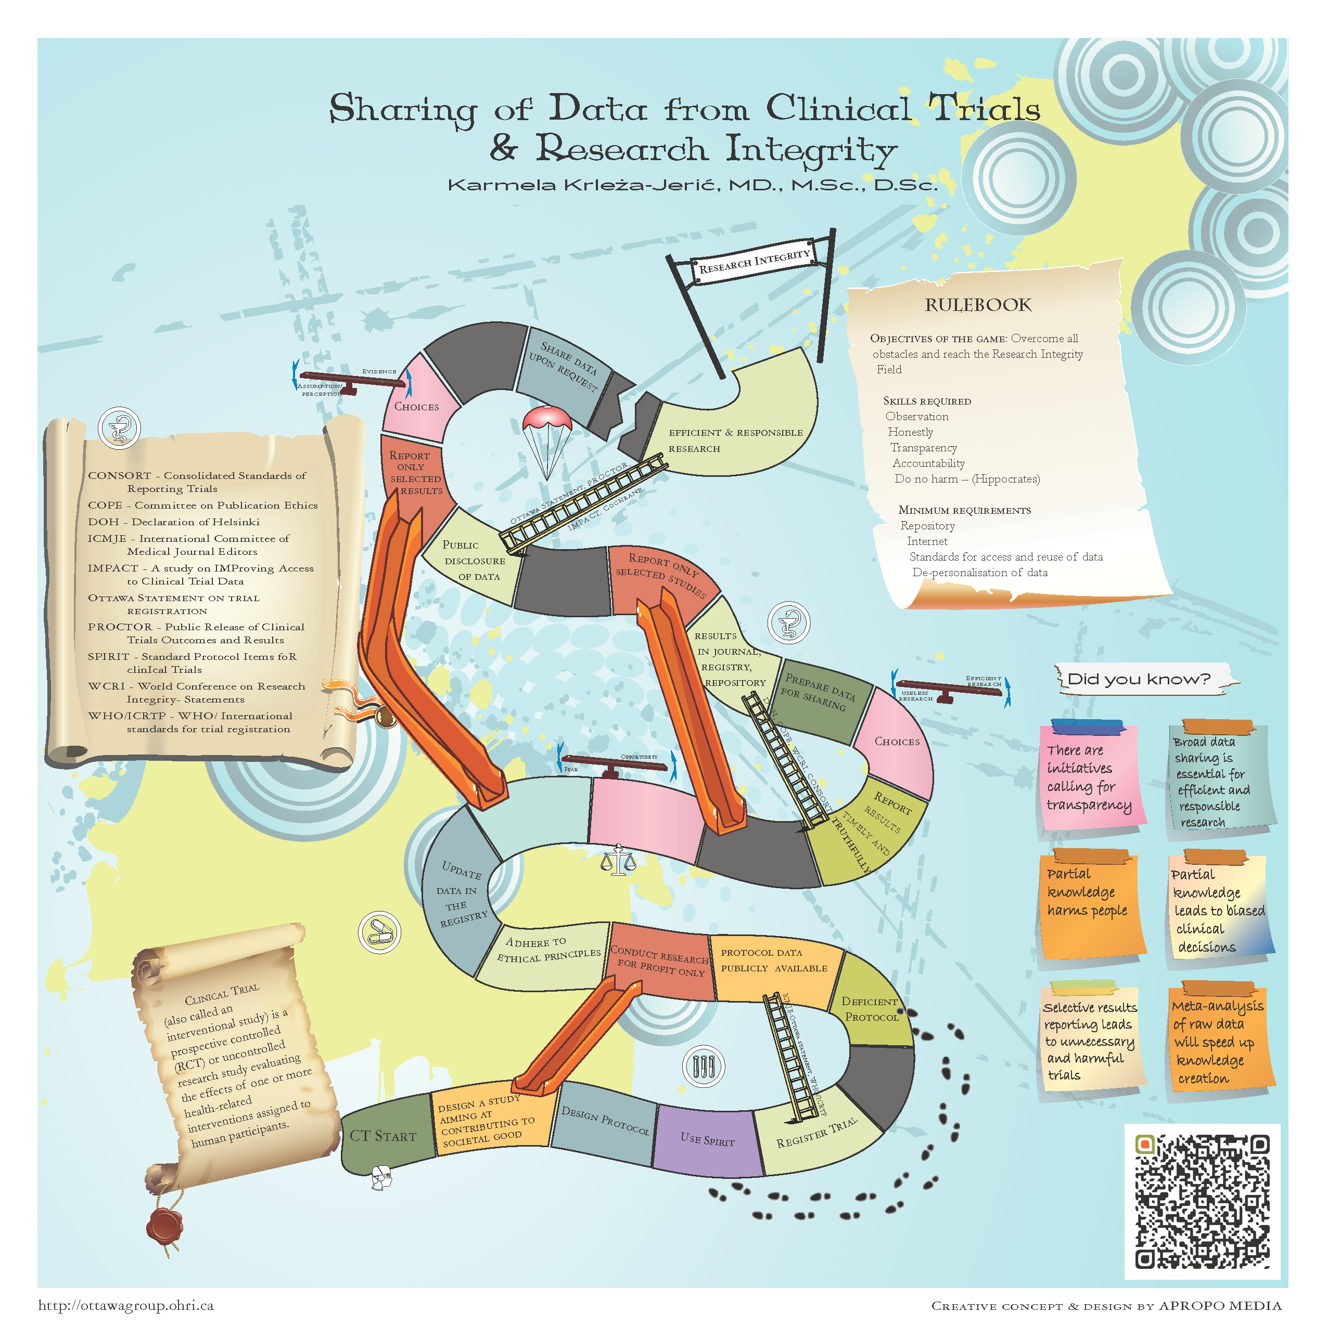
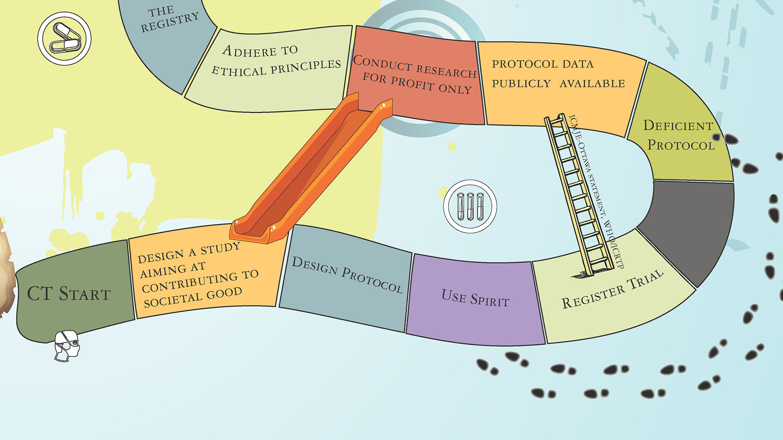

Slide 32
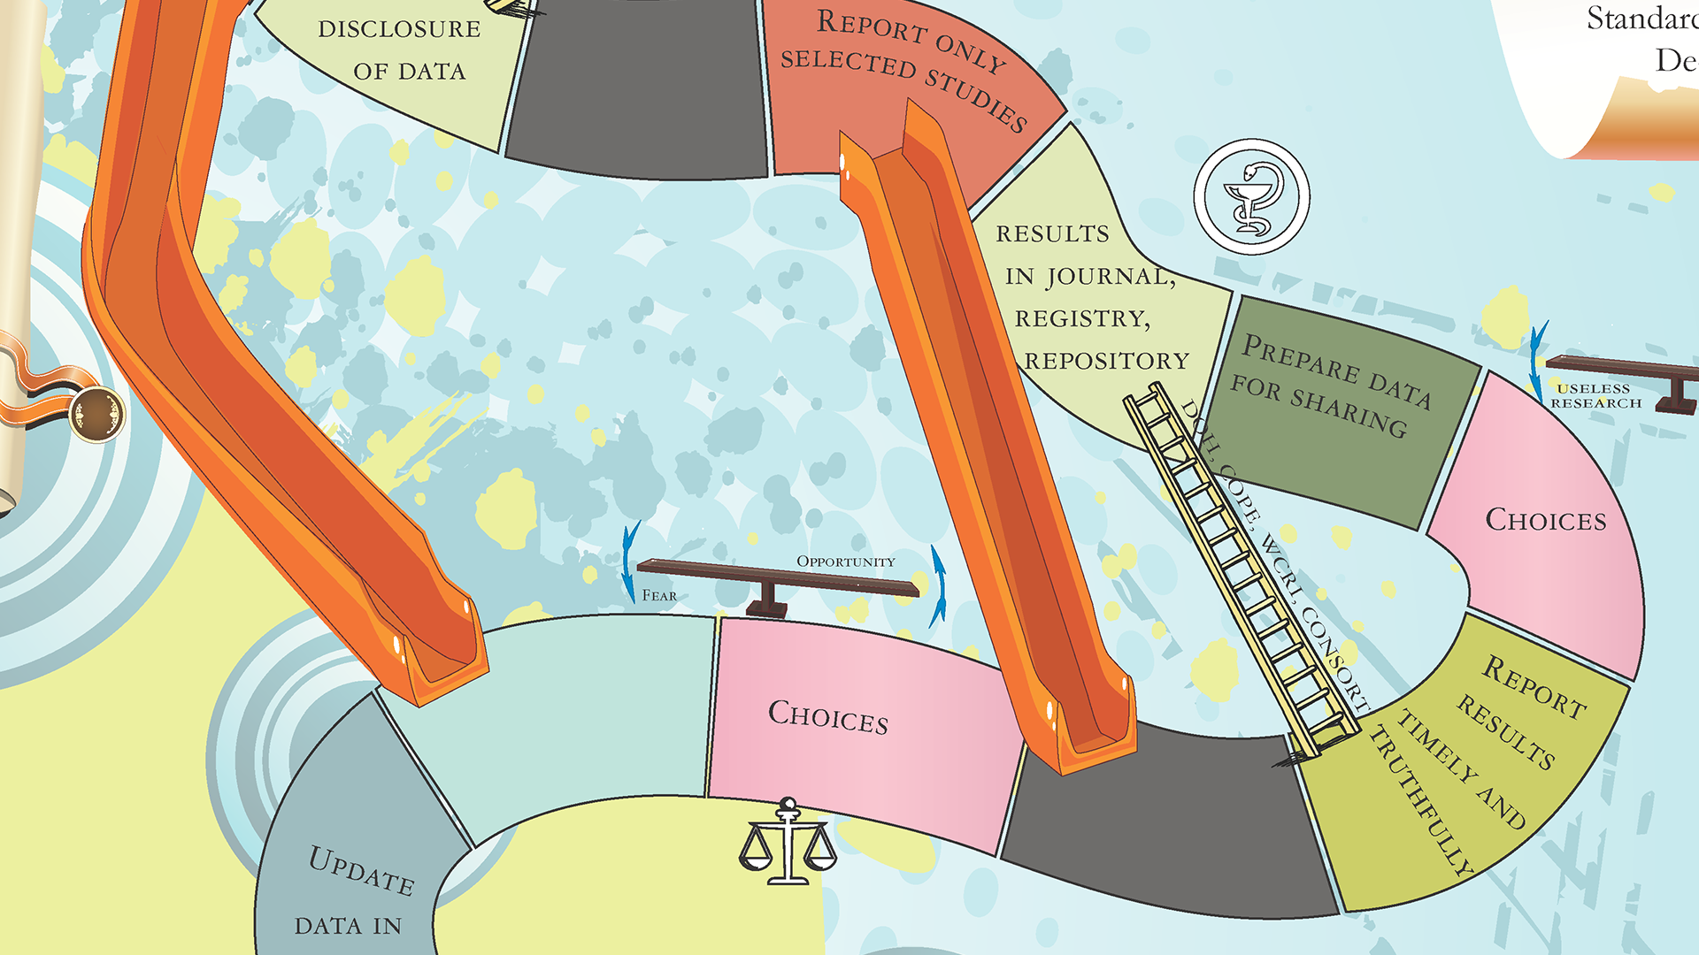

Slide 33
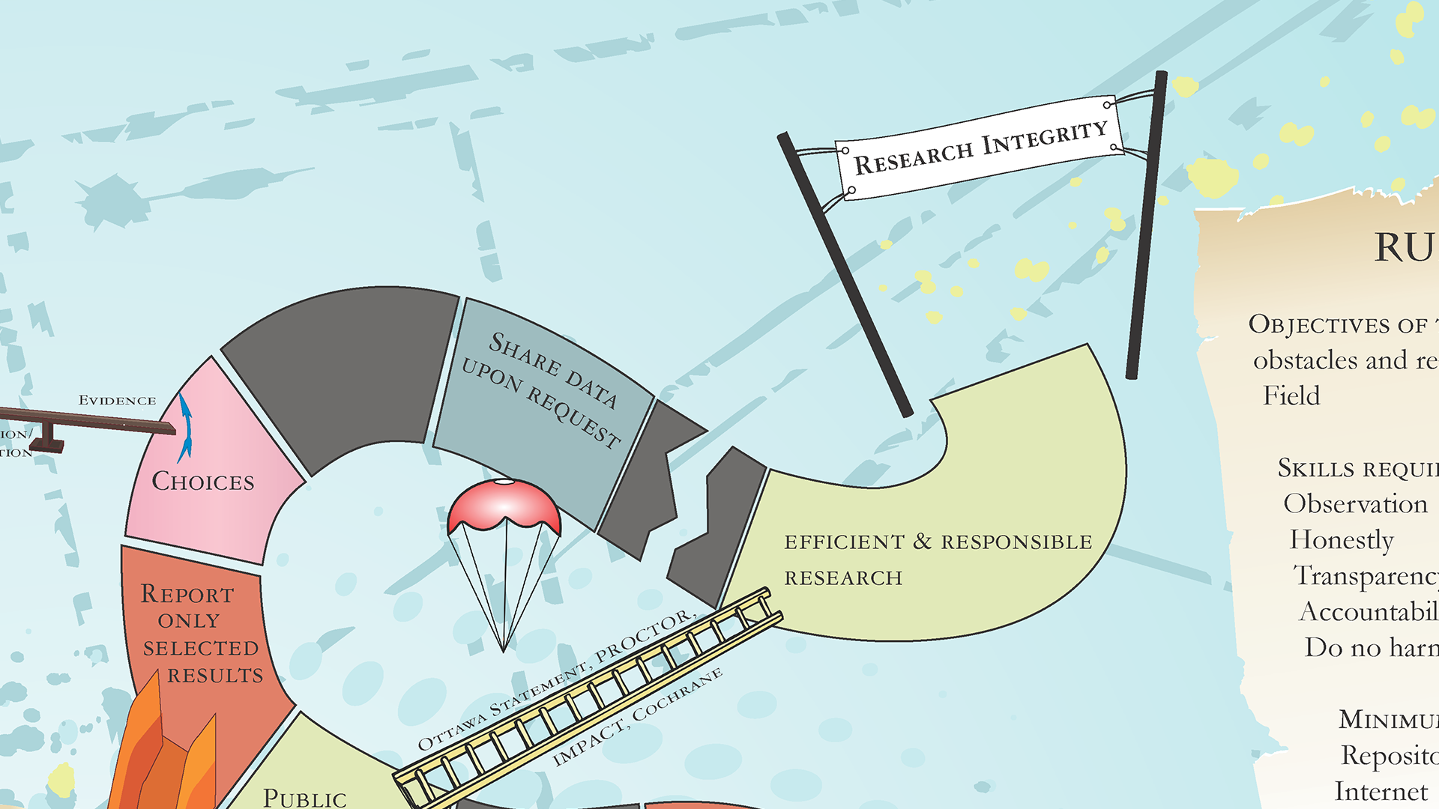

Slide 34
Invitation for
Contribution
Collaboration
Participation
krlezajk@hotmail.com

Slide 35
Acknowledgment
IMPACT Observatory network
Ottawa group, PROCTOR and IMPACT initiatives
Committee on Publication Ethics (COPE) for funding the environmental scan of repositories; research grant in 2012
fellowship for supporting the PI of the IMPACT Observatory in 2014
MedILS for hosting
Nevena Jeric, Apropo Media, for graphic solutions of the presentation

Slide 36
appendix

Slide 37
Sharing the story - always in open access
Editorial in Periodicum Bilogorum: https://hrcak.srce.hr/138067
Publication in Biochemia Medica https://www.ncbi.nlm.nih.gov/pubmed/27812300
MedILS: http://www.medils.org/research/impact-observatory
Presented at conferences Newfelpro http://www.newfelpro.hr/default.aspx?id=1277
Workshop in Australia: https://openmq.com.au/course/IMPACT001
Figshare: https://figshare.com/authors/Karmela_Krleza-Jeric/98936

Slide 39
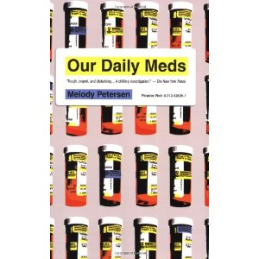

Slide 41
Privacy- Anonymisation

Slide 42
Diving Into Clinical Trials
by Natalie Salat
January/February 2007, 56-58.
https://legionmagazine.com/en/2007/01/diving-into-clinical-trials/

Slide 43
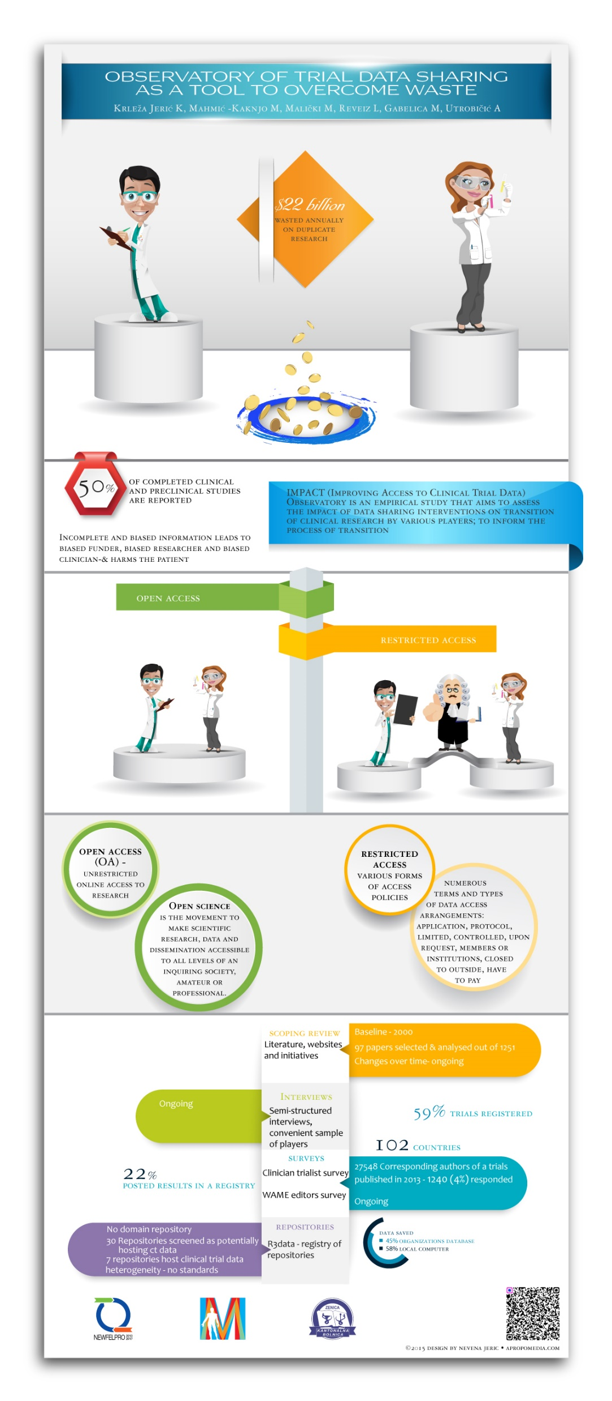
IMPACT Observatory
as a Tool to Overcome
WASTE

Slide 44
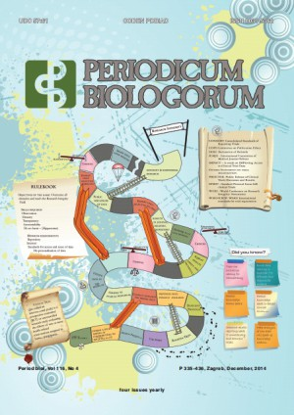

Slide 45
