Slide 1
Karmela Krleža-Jerić, MD. M.Sc. D.Sc. Ottawa Group, IMPACT Observatory karmela@krleza.com & krlezajk@hotmail.com
Access to clinical trial data (part 2):
the IMPACT Observatory and managing privacy risks
Part 2.1.
IMPACT Observatory: methodology, scoping review,
interviews, and surveys
Cochrane - GESI Webinar 2019

Slide 2
Karmela Krleža-Jerić
No conflict of interest
But interest in research &
public disclosure of research data

Slide 3
I am
Consumer advocate - member CCNET
Consumer coordinator Croatian Cochrane
Study participant
MD, D.Sc
Researcher
Visiting scientist @ MedILS and Visiting scholar @ EHIL

Slide 4
Memento – Hippocrates
…and I will use regimens for the benefit of the ill in accordance with my ability and my judgment, but I will keep from them those that might harm them.
The health of my patient will be my first consideration….

Slide 5
part 2
IMPACT Observatory and what we learned from its studies
Privacy and anonymization
Inspire
thinking on how to get responsible, efficient, research that would give trustworthy evidence
joining the IMPACT Observatory network

Slide 6
Poll 1
Please define yourself: (Yes/No- check all that apply)
Patient (someone with a personal experience of a health condition)
Care giver
Member (volunteer or paid) of health related associations, including NGOs & patient org
Decision maker
Health professional

Slide 7
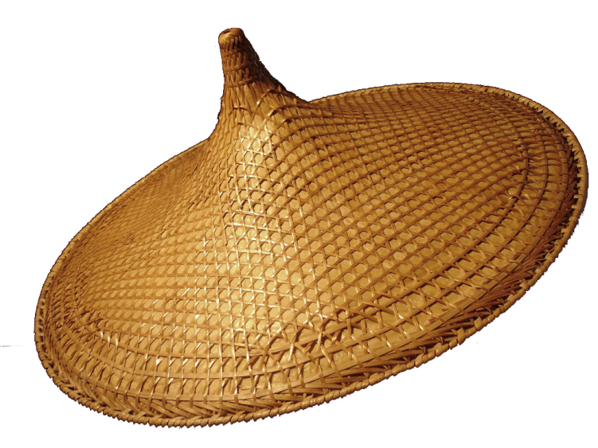
Open access to trial data
Prospective trial registration and public disclosure of results , data and all related documents
culture, initiatives, actions, shift of paradigm
define how-what-where-use

Slide 8
IMPACT Observatory
IMProving Access to Clinical Trial data - IMPACT Observatory
of
ongoing transition in clinical research regarding data sharing;
opportunities and barriers

Slide 9
Observatories or natural experiments
are epidemiological studies that
assess the impact of one or several interventions that are not controlled by the observatory researcher(s)
to inform the process and indicate trends.
IMPACT Observatory: multiple players act on CT data sharing with a consequent impact on the CT enterprise.
Krleža-Jerić, Karmela et al. “IMPACT Observatory: tracking the evolution of clinical trial data sharing and research integrity.” Biochemia medica vol. 26,3 (2016): 308-307. doi:10.11613/BM.2016.035

Slide 10
IMPACT OBSERVATORY
impact the transition of data sharing & of research
indicate potential trends; suggest improvements
assess barriers, gaps and opportunities of opening clinical trial data
identify changes of culture, perceptions policies and practice; dynamics and roles of players

Slide 11
IMPACT Observatory story
Ottawa Statement
Planning Meeting IMPACT Ottawa (British High Commission, University of Ottawa, participants)
PROCTOR
Ottawa (CIHR-IRSC)
NY vs GSK
2004
2006
2008
2012
2013
2014
ICMJE
IMPACT Observatory NewFelPro Fellowship
WHO
Trial registration standards
Environmental Scan of Repositories of Clinical Research Data

Slide 12
IMPACT Observatory
Aims to
assess transition of data sharing
increase
reliability of evidence
research integrity
quality of studies
contribute to
speeding knowledge creation – innovations- health interventions
overcoming research waste
avoiding unnecessary & harmful trials
regaining public trust
indicate trends – inform- impact transition
contribute to health

Slide 13
Changes
culture of researchers regarding
data sharing
research of existing data
policies of
regulators
funders
journals
pharmaceutical industry (pharma)
academia
standards
initiatives and projects regarding
access to data
data repositories
features
policies
standards for data accepting, curatorship and sharing
partnership
registries of repositories
features

Slide 14
IMPACT Observatory challenges
Complex; numerous players; their culture, actions & interactions
Build and maintain network
Connect the dots

Slide 15
Issues and players
Preservation
Initiatives
Citability
Academia
Librarians
Access
Standards
Policy
Researchers
Media
Funders
Infrastructure
Publishers
Consumer Advocates
Patient Groups
Journals
Culture
Knowhow
Repositories
Findability
Regulators
Decision Makers
Pharmaceutical Industry

Slide 16
Barriers 2012-2019
Repositories & data exchange standards
data format standards
accuracy quality
Privacy anonymization
Prepublication
Resources, policies
Citability
Availability
Findability
Culture
incentives
academic credit
Intellectual
property, TRIPS
Road to Public Disclosure

Slide 17
Potential development
IMPACT Observatory evolves in a long-term observatory and
Continues
assessing data opening process until data is open
Contributes to
data opening/access process
change of the research paradigm
refining methodology
Expands to other areas, test & adapt methodology as needed
Potential next steps:
IMPACT Observatory of aging research

Slide 18
Potential spin off
Identify analyzable IPD based data sets in selected repositories and
Test re-usability of such data
Assess
the extend data are shared and re-used
the add on value of IPD meta-analysis
Contribute to standards development
Change of paradigm

Slide 19
What is IMPACT Observatory
A tool, a Hub, virtual organisation
assessing and informing about the opening of CT data and related changes of research
aiming at contributing to a change of the CT paradigm due to data sharing changes

Slide 20
Who is IMPACT Observatory
Multi nodal network & team of people/ groups of people with good ideas and a good will
We are - anyone interested in increasing access to CT data

Slide 21
Methodology
Network/WG
Scoping review
barriers opportunities gaps
Surveys & Interviews
Public release of findings
Indicate trends
Enviro scan Initiatives
Impact transition
Enviro scan of Repositories

Slide 22
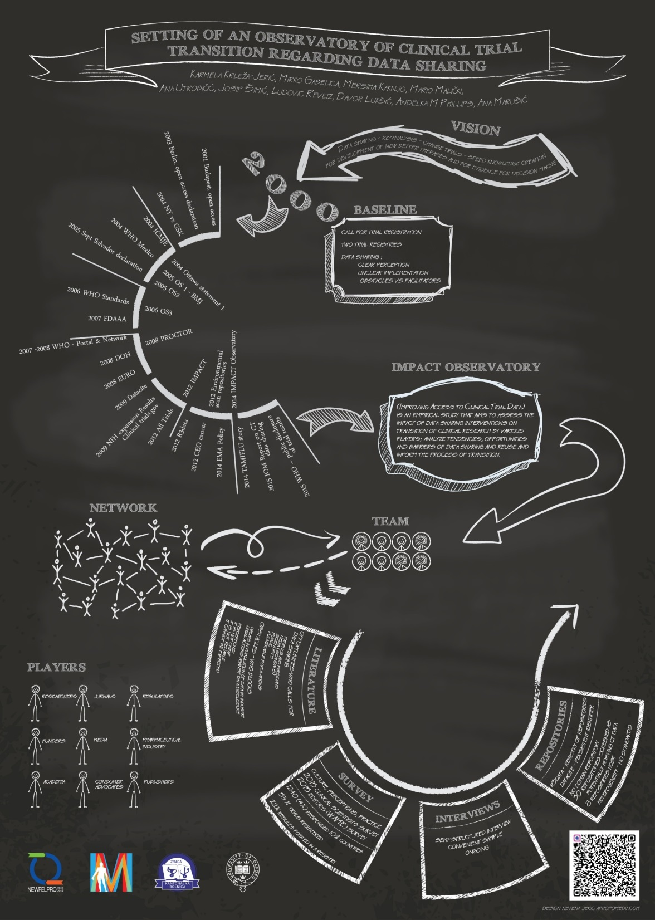

Slide 23
Methodology
Network/WG
Scoping review
barriers opportunities gaps
Surveys & Interviews
Indicate trends
Enviro scan Initiatives
Impact transition
Enviro scan of Repositories

Slide 24
Scoping review
A process of
Scanning & mapping literature and other sources on a specific topic
identifying key concepts, theories, and sources of evidence
aiming to better understanding phenomena

Slide 25
Scoping review
Advantages:
flexible
Challenges
language –terms - translations
no specific MESH terms
Media , Social media

Slide 26
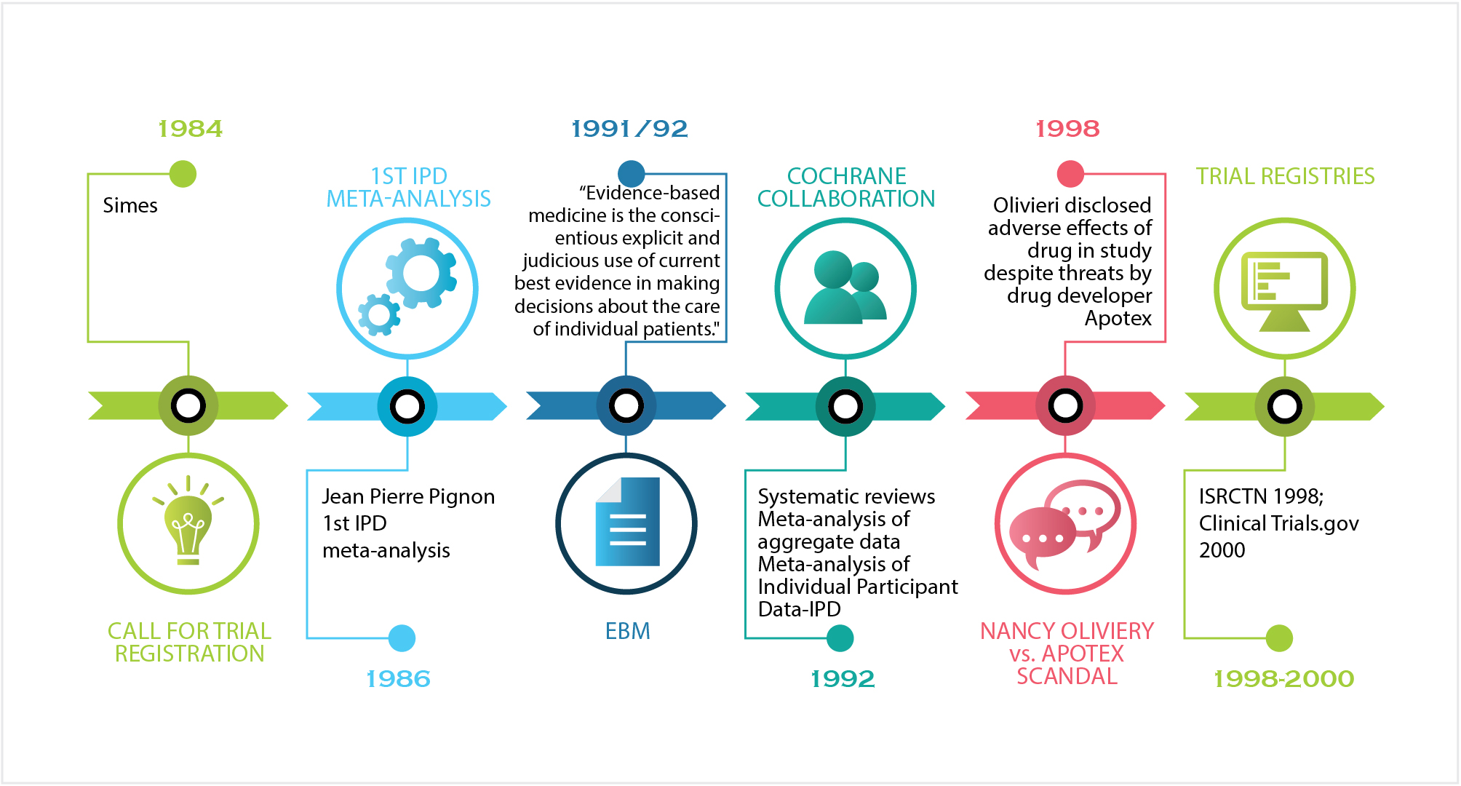
Baseline- Key Milestones
Mahmić-Kaknjo M, Šimić J, Krleža-Jerić K. Setting the IMPACT (IMProve Access to Clinical Trial data) Observatory baseline. Biochem Med (Zagreb). 2018;28(1):010201.

Slide 27
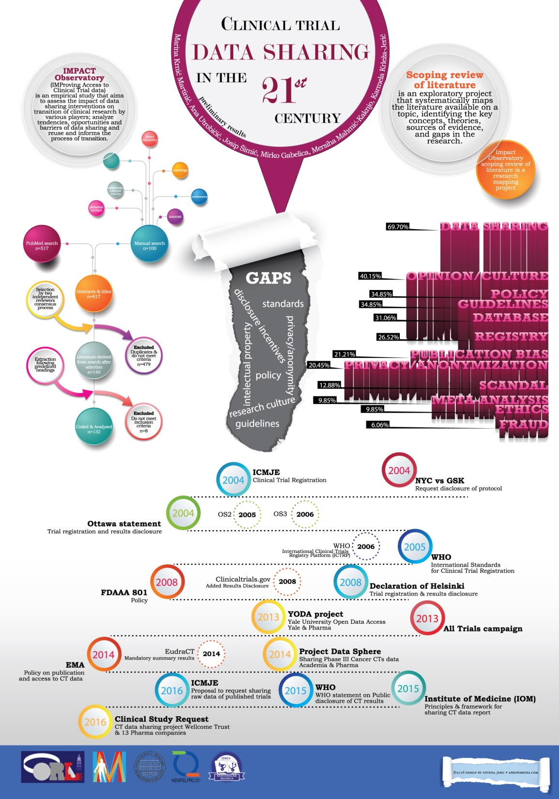
Ongoing Scoping review of CT data sharing in
21st Century
Croatian Cochrane Symposium Split, Croatia 2016

Slide 28
access
From: Krleža-Jerić K.et al. Observatory of trials data sharing as a tool to overcome waste-IMPACT Observatory, Poster; Reward Equator Conference; Increasing value and reducing waste in biomedical research conference. Edinburgh, 28-30 Sept, 2015
.

Slide 29
Methodology
Network/WG
Scoping review
barriers opportunities gaps
Surveys & Interviews
Indicate trends
Enviro scan Initiatives
Impact transition
Enviro scan of Repositories

Slide 30
Surveys and Interviews
Culture- perception-opinions-positions- policy-practice
Interlinked –mutually informing
Interviews are still going on

Slide 31
Interviews
We analyzed one interview from each of six key constituencies/ players:
academia
consumer/study participant
editor
funder
pharma
researcher

Slide 32
Interviews - key messages across
data should be shared but
data opening will take place gradually
international standards are essential; standards for anonymization, & standards to prepare data for public release
standards should be developed by an independent international, trustworthy organisation (such as WHO)
data should be in format that would enable their future use ie analysis; consumer specified that they should be shared electronically, on the Internet.
data from publicly funded studies should be made publicly available

Slide 33
Interviews
Change of culture
Interviewee from academia:.”So we’ve been going through an interesting exercise in ethics committees…We have been telling researchers that all their data is confidential, and they must not give it away and that they have to keep it secure and safe, and now we are trying to turn it around….. and make data publicly available”

Slide 34
Surveys of players
Internet/ WEB based surveys: Monkey and Qualtrics
Journals editors – WAME 2009: N=108 and 2015: n= 85
Clinician trialists 2015: N=2250
Consumers and patient groups:
CCNet 2017: N=65
Italian patient and citizen organizations 2017: N=280
Croatian Cocharne Partner Organisations 2018: N=52

Slide 35
survey comparison: what should be publicly available

Slide 36
trialist survey

Slide 37
needed for sharing raw data
needed for sharing raw data
75%
75%
Anonymization
Anonymization
70%
70%
Data preparation methods
international
standards
Data preparation methods
72%
72%
Standards data sharing and reuse
Standards data sharing and reuse
68%
68%
Repository standards
Repository standards
42%
42%
Ethically verified researchers
Ethically verified researchers
56%
56%
Registration needed
Registration needed
63%
63%
Researchers guarantee not to identify
Researchers guarantee not to identify
68%
68%
Legal mechanisms to punish misuse
Legal mechanisms to punish misuse
18%
18%
Other
Other
CCNET survey

Slide 38
consumers on data sharing
Italian groups
reduce unnecessary research
study adverse reactions to treatments
Croatian
transparency; the right to know
assessment of errors
progress of science

Slide 39
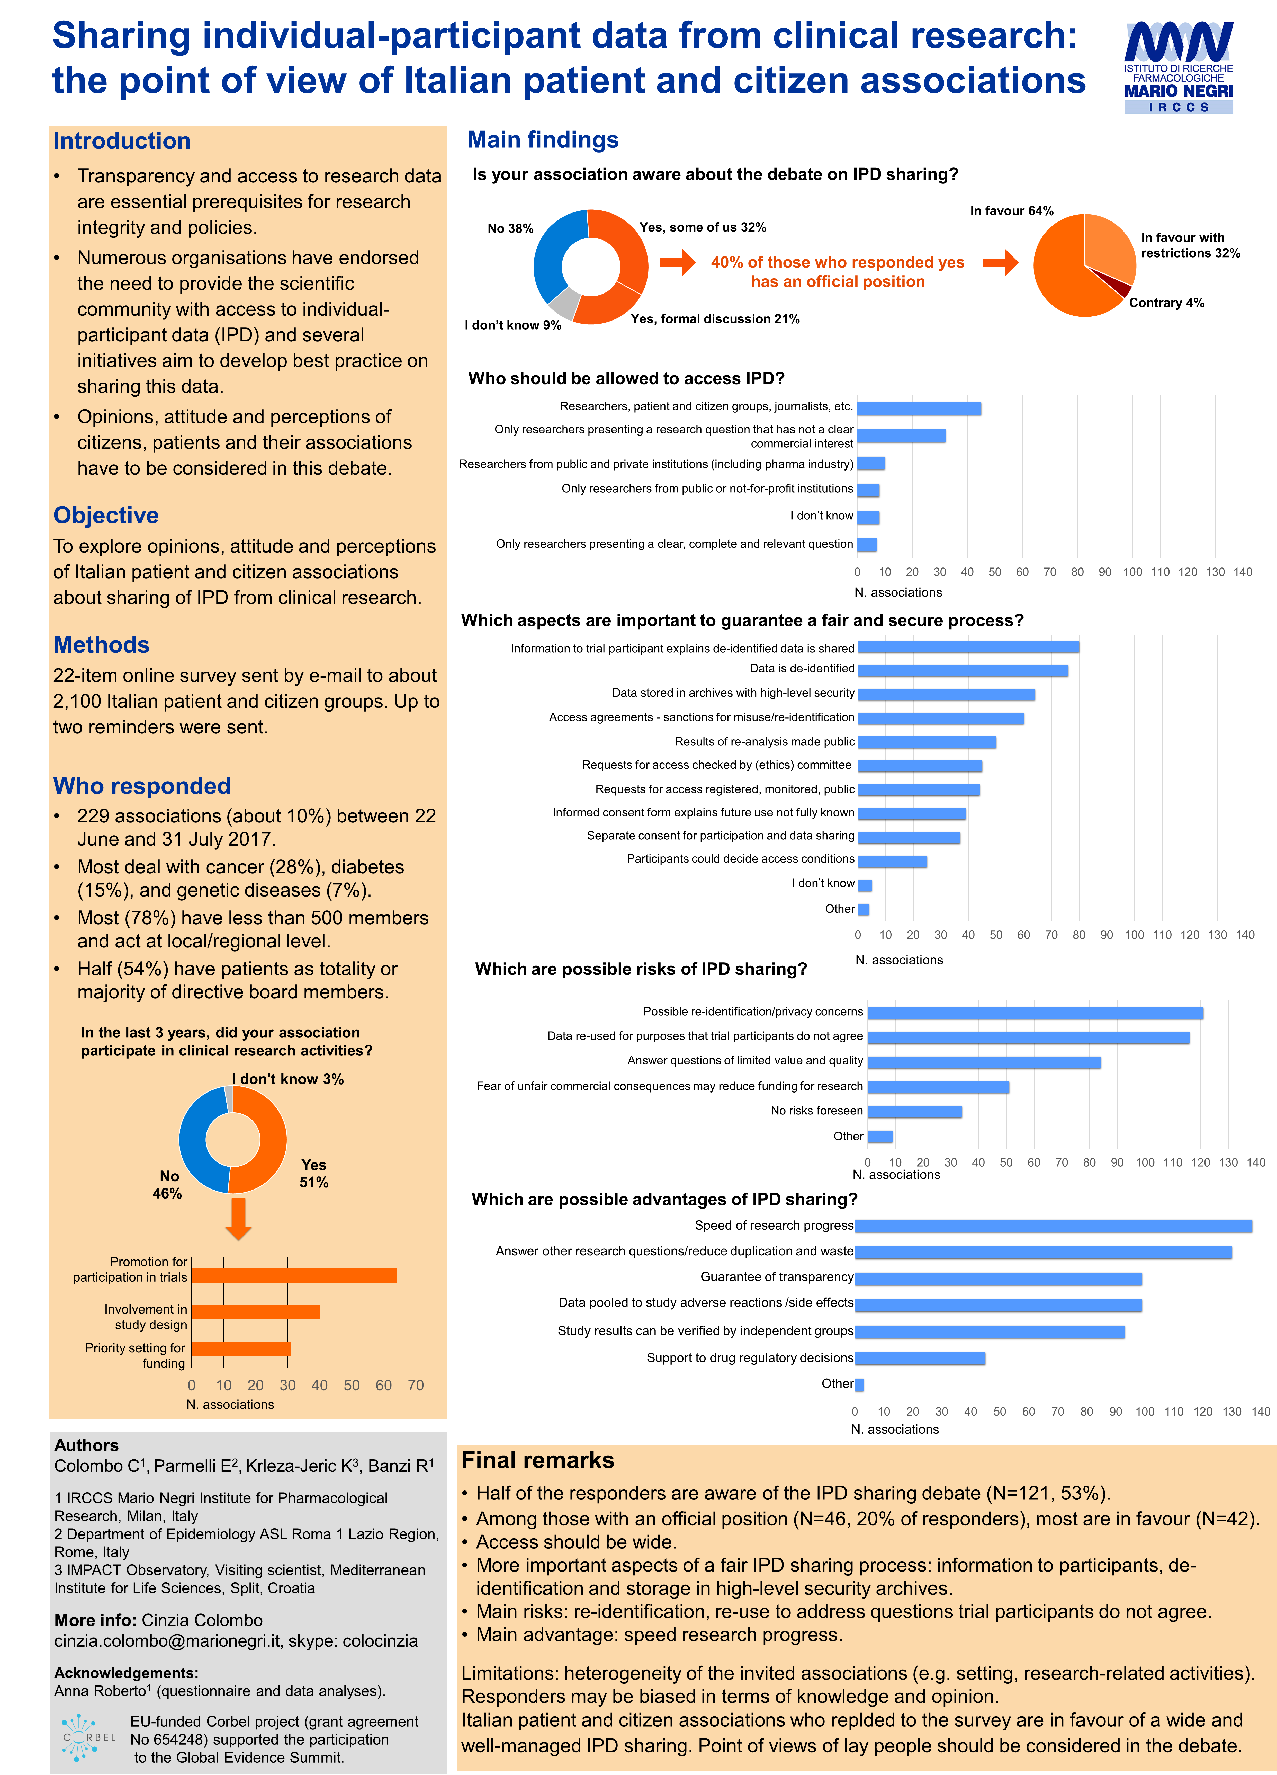

Slide 40
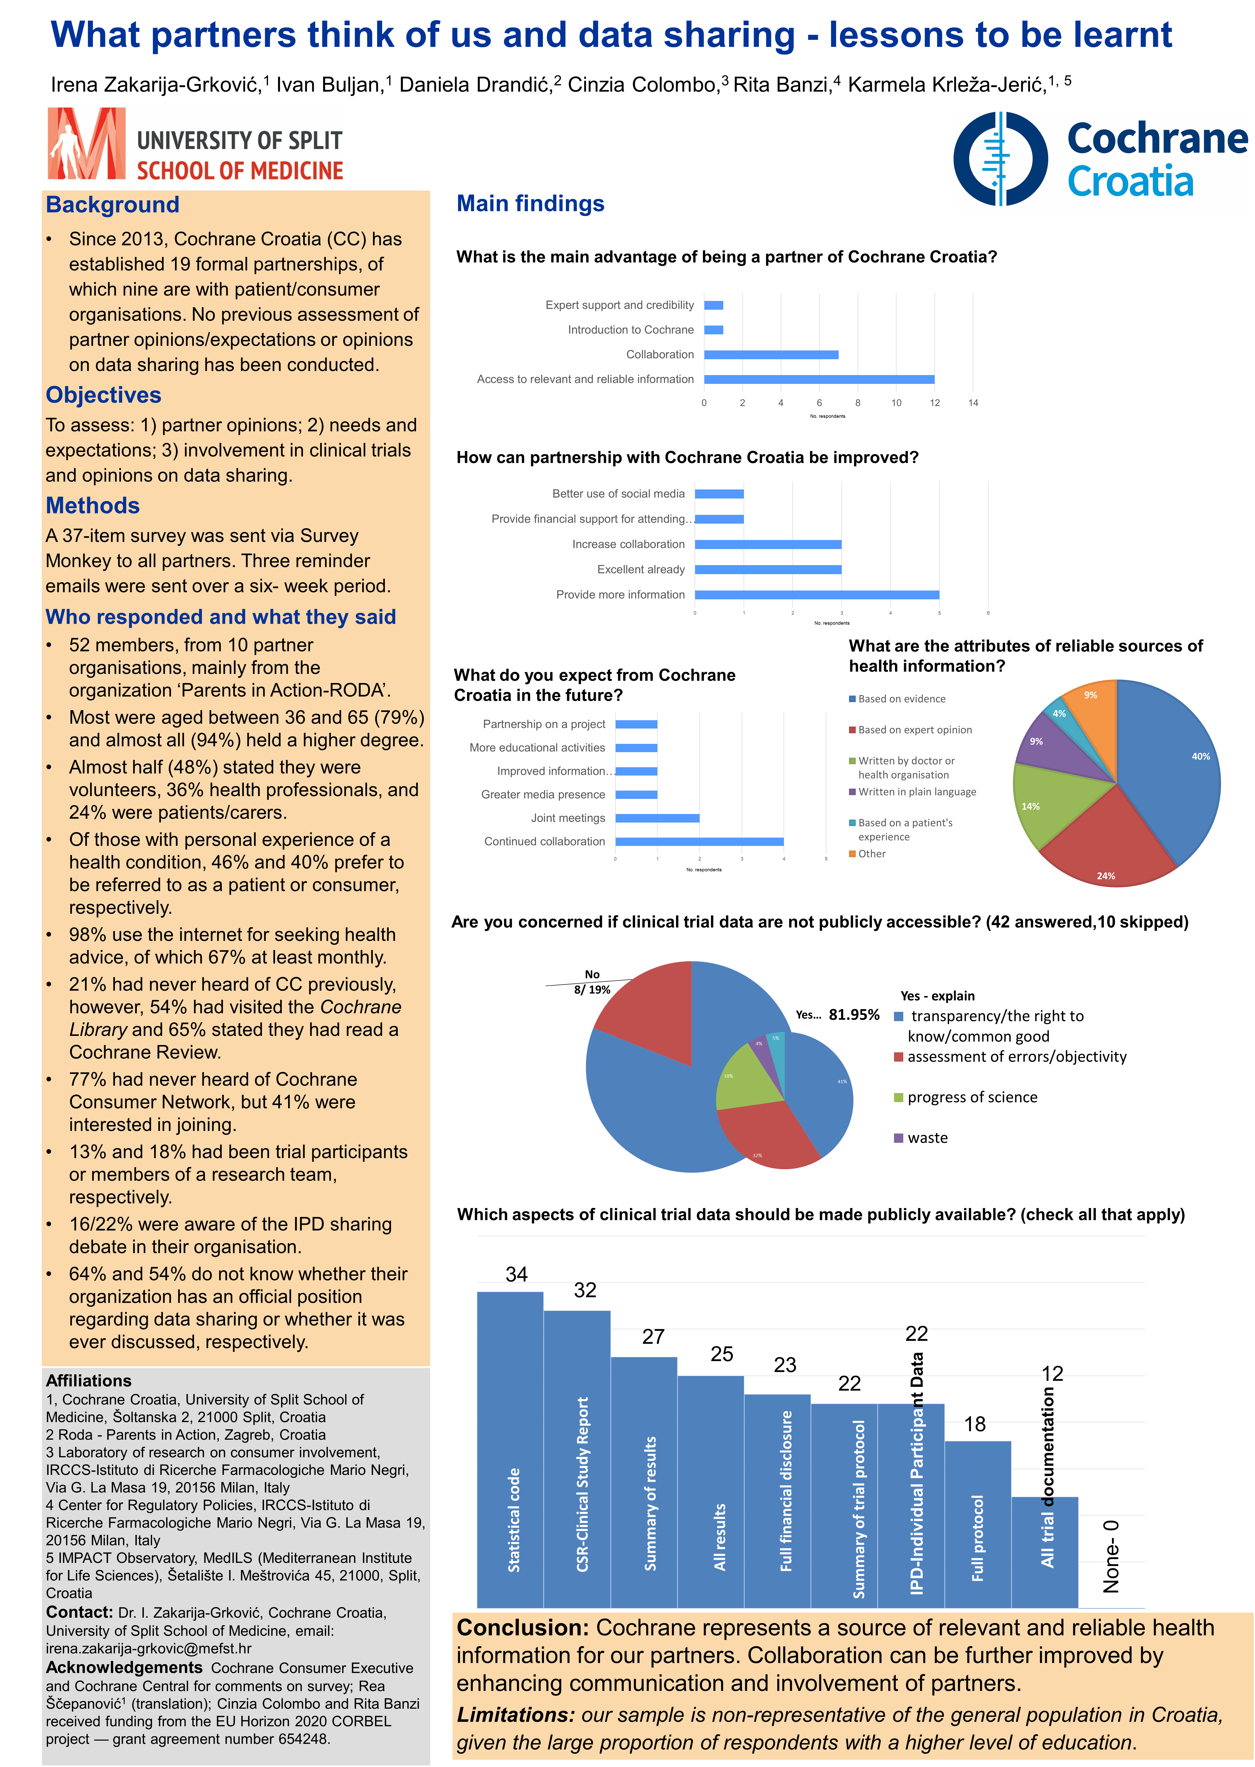

Slide 41
Poll 2
Did you ever participate in a clinical trial as
(check all that apply)
Study participant
Member of the study team
None of the above

Slide 42
Anonymization
Anonymization needed for data sharing
Trialists (n=1804)– highly rated: 7.8 of 10
CCNET (n= 57) : 75%
Italian (n=131): 66.4%
Also re-identification a risk (n-258): cca 50% but if they knew about the IPD debate 61.6% vs 38.4% consider re-identification a risk

